Slide 1
Stewardship Workshop
The Episcopal Church
in South Carolina

Slide 2
Statistics
Over 50% of people who attend church give nothing.
Only 5% give 10% or more.
6 out of 10 millennials prefer to give online.
Last 20 years, income is up 900%, giving is down 50%

Slide 3
Agenda
What is TENS
How to use TENS resources to conduct a stewardship campaign
Best practices for stewardship
Questions and Answers
Development

Slide 4
The Episcopal Network for Stewardship
TENS’ vision is to provide training and resources for stewardship leaders across The Episcopal Church.
The diocese has paid for a membership for all of our churches to use.
This provides free resources for you to use in your stewardship campaigns.

Slide 5
How to use
TENS 2014 Walking the Way Stewardship Narrative Series and annual giving campaign. To access the series go to the members-only section of the TENS website (www.tens.org) and enter (using all lower case):
Username: ****** (please contact the Diocesan Office for log-in information)
Password: *****
The Walking the Way series will guide your congregations through a six-week campaign step by step. This year eight contributing writers reflect on the Gospel lection beginning Sunday, October 5th and continuing through Sunday, November 9th, weaving in a stewardship principle or practice and inviting the reader to reflect on their own journey of giving and their walk with Christ.

Slide 7
Walking the Way Essential Steps in Planning Your Annual Giving Campaign
June 6, 2014
The Rev. Laurel Johnston
Executive Director
The Episcopal Network for Stewardship (TENS)
Kristine Miller, CFRE
V.P. Horizons Stewardship and TENS Board Member

Slide 8
Jesus Money & Values
Jesus challenged the disciples, scribes and the crowds about relationship to money and their possessions.
Scripture references:
Prayer 500 times
Faith >500 times
Money 2,000 times

Slide 9
GIVING IS WORSHIP
The practice of the tithe was an
outward acceptance of
Yahweh’s authority in
the covenant partnership

Slide 10
The Way is made by walking….

Slide 11
The Purpose of a Stewardship Ministry is to help
people grow in their relationship with Christ
through the gifts God had entrusted to them.
Notes:
The Purpose of Stewardship Ministry is to help
people grow in their relationship with Christ
through the giving back blessings God has entrusted to them.

Slide 12
The Annual Giving Campaign is Discipleship Formation
Giving as Spiritual Discipline
A Concrete Expression of Worship & Gratitude
Funding God’s Vision through Your Congregation

Slide 13
Walking The Way Stewardship Series & Annual Giving Campaign
Nine bulletin inserts
Letter from the Rector/Vicar
Letter from the Senior Warden
Letter from the Stewardship Chair &
Ministry Team
Pledge card,
Prayers of the people,
Prayer over the pledge cards
Thank you letter.
Available in Spanish, Chinese and Korean
Notes:
Is it 9 bulletin inserts?? 6 + extra for All Saints Sunday; St. Francis
Also letter appropriate for each category of giver

Slide 14
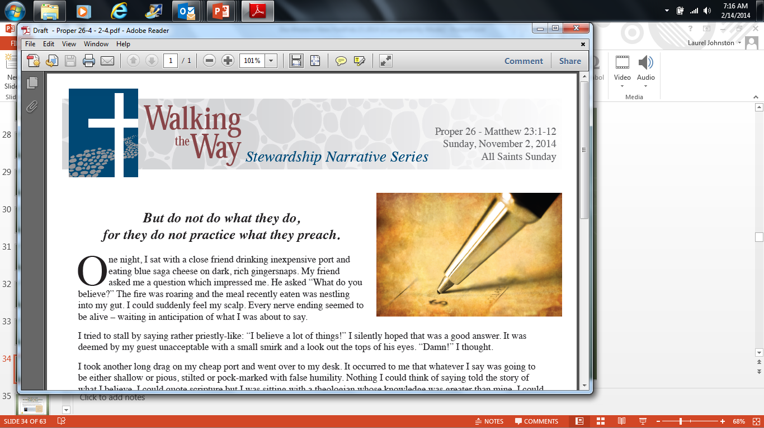
Walking the Way Six Week Stewardship Narrative Series October 5-November 9 2014

Slide 15
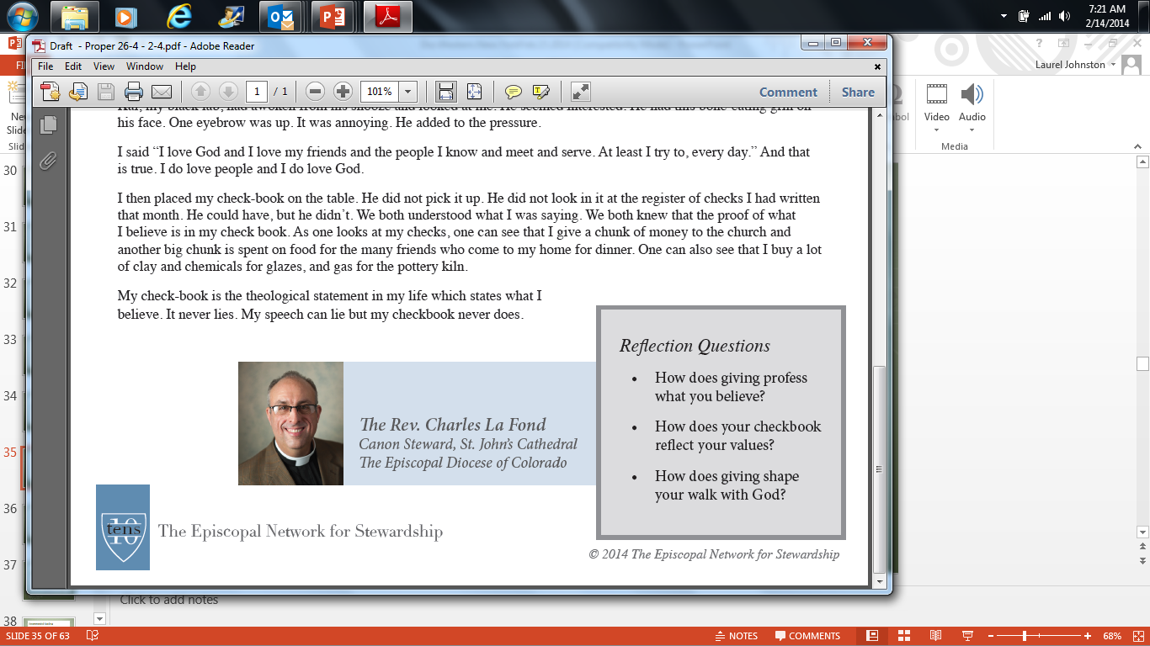
Walking the Way Six Week Stewardship Narrative Series Reflection Questions

Slide 16
Targeted Mailings Meeting People Where They Are
New members/New to pledging
Contributors whose giving has remained the same
Contributors who are proportionally giving
Contributors who tithe
Notes:
Letters from Rector reflect an understanding of where people are on the journey

Slide 17
The Journey
Grounded in Gratitude
Revealed in Prayer
Lived in Faith

Slide 18
Gratitude Begins the Journey
I am grateful to God for…
Gratitude Graffiti
Gratitude tree
Walls of Gratitude
Notes:
Lucky v blessed

Slide 19
Gratitude Begins the Journey

Slide 22
Prayer Lights the Way
21-day devotional
www.horizonsstewardship.com
Stewardship Prayer for lectionary
www.gbod.org
Use Walking the Way bulletin inserts to encourage discussion
Write stewardship prayer and use it during Prayers of the People

Slide 23
Faith Makes it Happen
Testimonies
Gratitude, Prayer and Faith as elements on the journey
Pledge cards in worship
Brought forward and placed on the altar as an act of worship
Options for everyone

Slide 24
Thank You & Follow Up
We are a Eucharistic People: We give thanks!
Personal Handwritten Notes from Rector/Vicar
Thank You Letter from Stewardship Chairs
Phone Calls
Quarterly Statements of Giving: Opportunity to give thanks
Express Gratitude year-round
Monthly Phone Calls/Emails
Affirmation of Ministries

Slide 25
Questions?

Slide 26
Best Practices
Weave in the concept of stewardship on monthly basis
- Start with annual meeting
You are already talking about money.
Make sure the time is convenient to everyone.
Have childcare for children 0-12.
Balance number/budget reporting with program details & photos
Consider running a list of names, for those who pledge, as a thank-you
Incorporate opt-out on pledge card

Slide 27
How often are you mailing statements?
…. and to whom?
…. and at what time of year? …. at what intervals?
Use this mailing as a time to highlight what money is being used for i.e. increased VBS numbers or new Outreach projects or even a simple, mid-year, “thank-you” from the Rector for one’s presence in the parish

Slide 28
Online Presence & Stewardship
Is the term Giving or Stewardship on your web site’s homepage? How many clicks does it take to find a “mention?” Are there enough details there to make various types of gifts?
Can one use a credit or debit card to make a gift to the church?
Start now with making a plan to adopt this
Second best option, offer & market automatic bank drafts
Can one make a pledge online?
Follow-up to annual appeal

Slide 29
Planned Gifts & Stocks
Begin mentioning the concept of leaving a bequest to the church in one’s will in bulletin, newsletter, and website.
All Saints’ Day or New Year’s or after Easter
Simple one-liners like “Is God’s will in yours?”
Pg. 445 of BCP
Are you set-up to receive gifts of stock?
Promote on pledge card, web site & in December

Slide 30
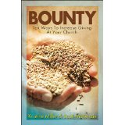
Recommended Reading
Bounty: Ten Ways to Increase Giving at Your Church
by Scott McKenzie and Kristine Miller
Fearless Church Fundraising by Charles La Fond

Slide 31
Development

Slide 32
Budget Data
2013 budget receipts from parishes and missions $251.625.29
2013 budget expenses for Mar 1- Dec $483,988.00
2014 budget anticipate receipts from parishes and missions $344,295.00
2014 budget anticipate expenses $400,050.00

Slide 33
Parish Giving
Total pledged from parishes, missions and worship groups in 2014 is: $347,227.
Presently, we are on target for 2014 in receipts. As of the end of April we have received $127,440 from parishes, missions and worship groups.
Receipts of $50,000 from individuals so far in 2014.

Slide 34
Diocesan Statistics
10 Parishes
17 missions
3 Worshipping Communities
9 churches with full-time clergy,
7 with part-time clergy,
1 with bi-vocational clergy,
10 without a priest in charge- they rely on supply
There are currently 8 groups (5 newest missions, and 3 Worshipping Communities) that do not own their own church/building. They currently lease a space, or are welcomed into space of other denominations.

Slide 35
Goals of Diocesan Development Committee and Bishop vonRosenberg
Parish giving to diocese 10% of annual budget
Individual giving to diocese
Annual fund to support operating expenses of diocese
Endowment to support salary of bishop and support of worshipping communities

Slide 36
Challenge from All Saints’ Hilton Head
The congregation of All Saints’- Hilton Head has issued a challenge to the diocese.
They are offering a matching gift, of up to $100,000 for those gifts made to TEC in SC.
Payable over 3 years, it is the intention to encourage giving and support of the development goals.
Won’t you be a part of this?

Slide 37
Why support TEC in SC?
Support of worshipping groups
The diocese has placed retired clergy in missions and regular supply positions.
TEC in SC helped coordinate an insurance claim for a parish which resulted in a new roof.
The bishop and archdeacon have made pastoral visits for parishes that were without a priest in charge.
TEC in SC has helped worshipping groups meet physical needs with such as hymnals, prayer books, patens and chalice, etc.

Slide 38
Clergy Transitions
Diocese has supported active clergy who wished to remain in the Episcopal Church by finding them a place in parishes in TECSC.
Clergy retiring to SC have a place to call home and can continue their ministries.
Multiple examples of priests and clergy

Slide 39
Mission and Outreach
Coordinated a funeral for a family from the upstate who wished to have a service in Sumter, where there was no Episcopal presence.
Support of Education for Ministry program.
Support of ¾ tuition for participants in a Provence IV HIV/AIDS retreat in 2013 and 2014.
Companion diocese with Dominican Republic.
Prison ministries – Good Friday service in Estill.

Slide 40
What are your stories?

